Slide 1
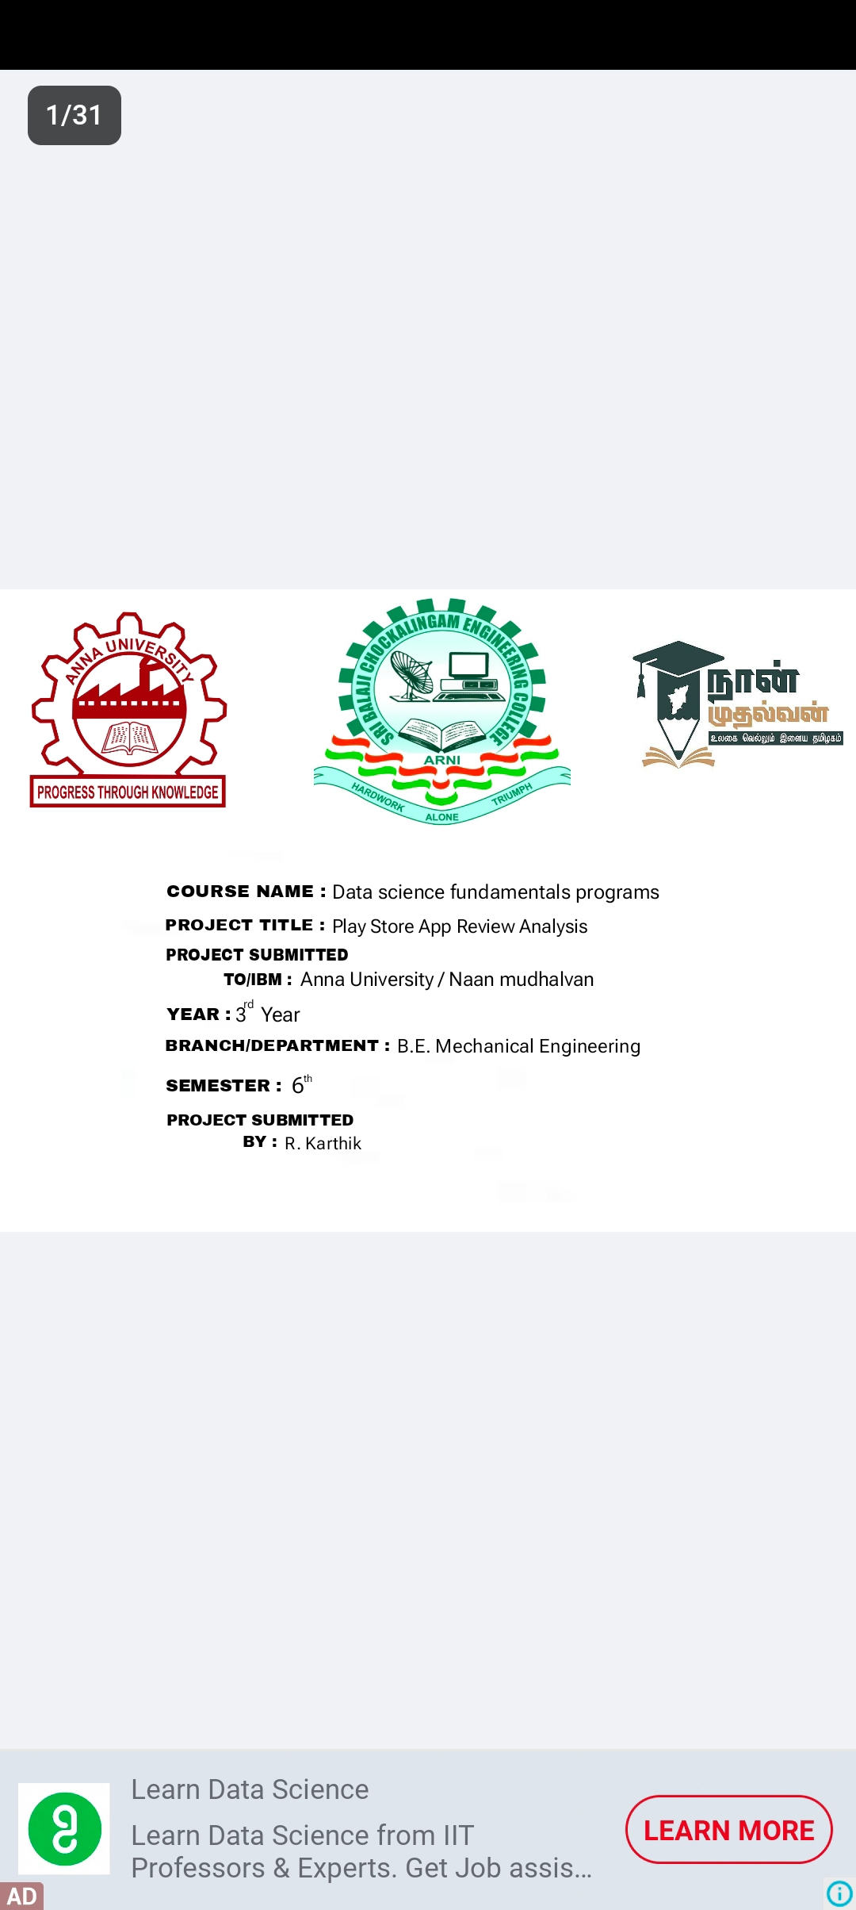

Slide 2
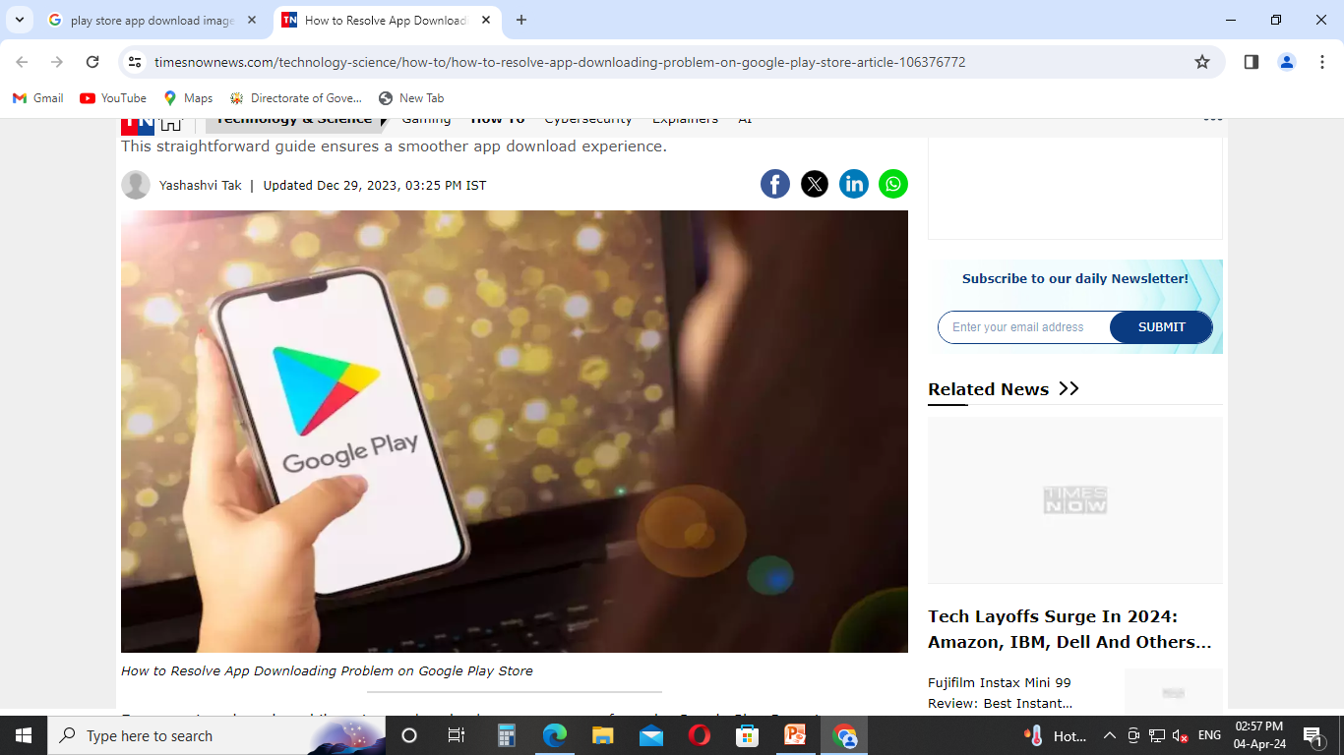
PLAY STORE APP REVIEW ANALYSIS

Slide 3
ABSTRACT
Our day-to-day life has always been influenced by what people think. Ideas and opinions of others have always affected our own opinions
. As the Web plays an increasingly significant role in people's social lives, it contains more and more information concerning their opinions and sentiments.
The distillation of knowledge from this huge amount of unstructured information, is also known as opinion mining and sentiment analysis

Slide 4
INTRODUCTION
Introduction Sentiment analysis is the process of classifying whether a block of text is positive, negative, or, neutral.
Sentiment analysis is contextual mining of words which indicates the social sentiment of a brand and also helps the business to determine whether the product which they are manufacturing is going to make a demand in the market or not

Slide 5
The goal which Sentiment analysis tries to gain is to analyses people’s opinion in a way that it can also help the businesses expand
It focuses not only on polarity (positive, negative & neutral) but also on emotions (happy, sad, angry, etc.).
Sentiment analysis is a technique with which we can identify and determine if data indicates a positive, negative or neutral emotion

Slide 6
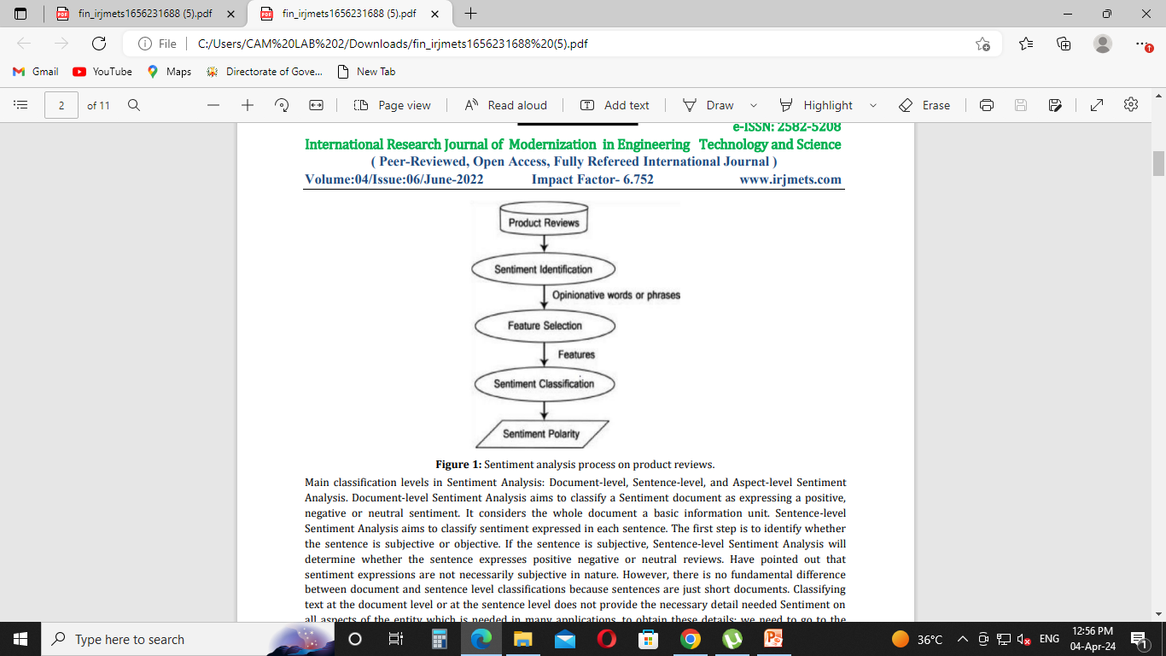

Slide 7
LITERATURE REVIEW
There has been a constant growth in the public and private information stored within the internet.
This includes textual data expressing people's opinions on review sites, forums, blogs, and other social media platforms.
Review based prediction systems allow this unstructured information to be automatically transformed into structured data reflecting public opinion.

Slide 8
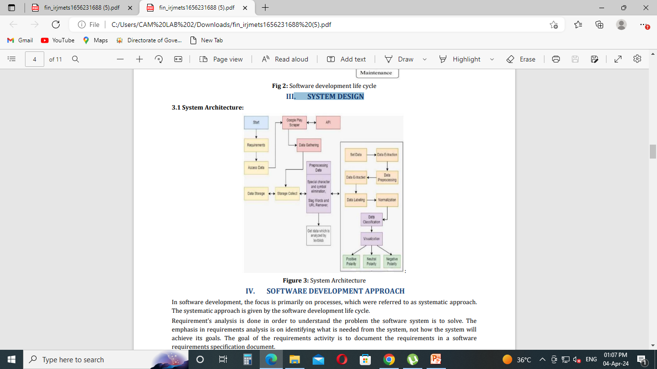
SYSTEM DESIGN

Slide 9
SOFTWARE DEVELOPMENT APPROACH
In software development, the focus is primarily on processes, which were referred to as systematic approach.
The systematic approach is given by the software development life cycle.

Slide 10
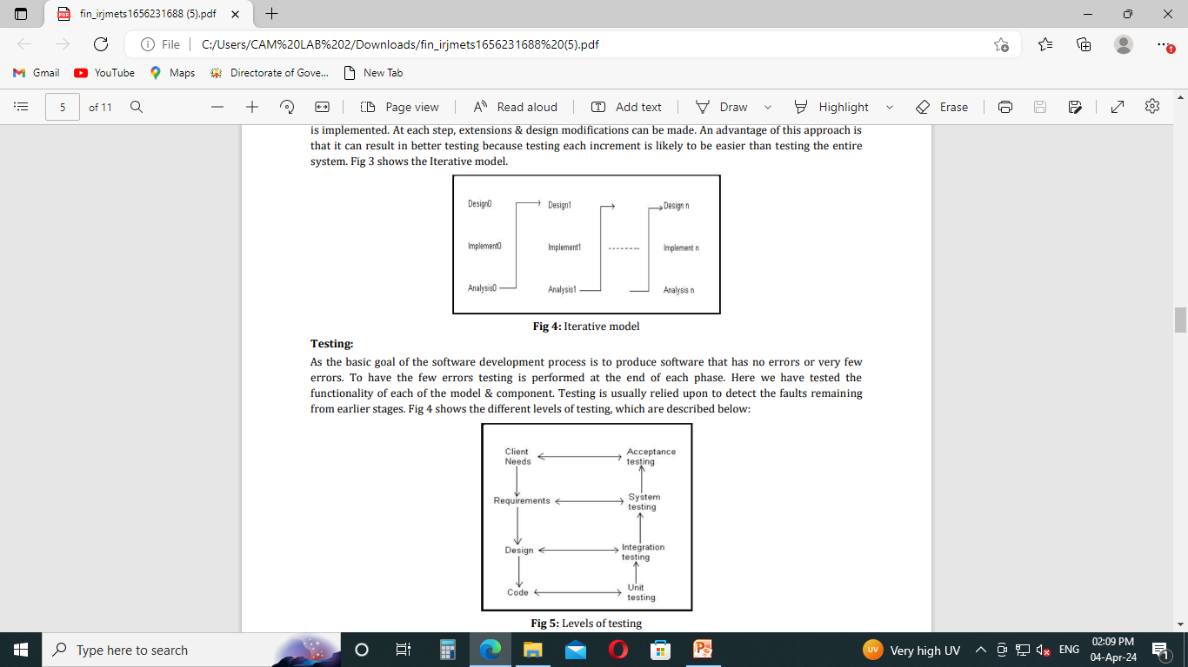
Software Development

Slide 11
TECHNOLOGY & LANGUAGE USED
Web Applications
Desktop GUI Applications
Console-based Application
Software Development
Scientific and Numeric
Business Applications
Audio or Video-based Applications
3D CAD Applications
Enterprise Applications
Image Processing Application

Slide 12
Django Framework in Python
Ridiculously fast - Django was designed to help developers take applications from concept to completion as quickly as possible.
Reassuringly secure - Django takes security seriously and helps developers avoid many common security mistakes.
Exceedingly scalable - Some of the busiest sites on the web leverage Django’s ability to quickly and flexibly

Slide 13
IMPLEMENTATION DETAILS
Mobile app distribution platform such as Google play store gets flooded with millions of new applications uploaded by developers every day.
So, in this project, we aim on analyzing Google play store that provides a particular app description and data such as reviews, ratings, price and number of downloads.
The objective of this is to analyses the desire of the customer through the reviews provided in the feedback section and apps trend in the market to help the organization & developers.

Slide 14
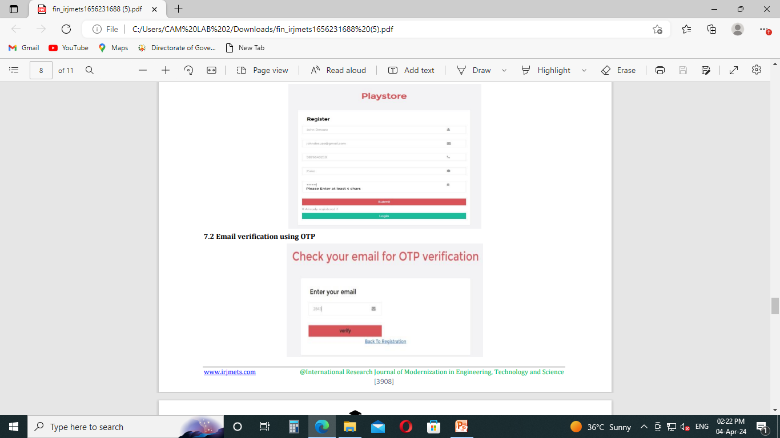
USER MANUAL (OUTPUT)

Slide 15
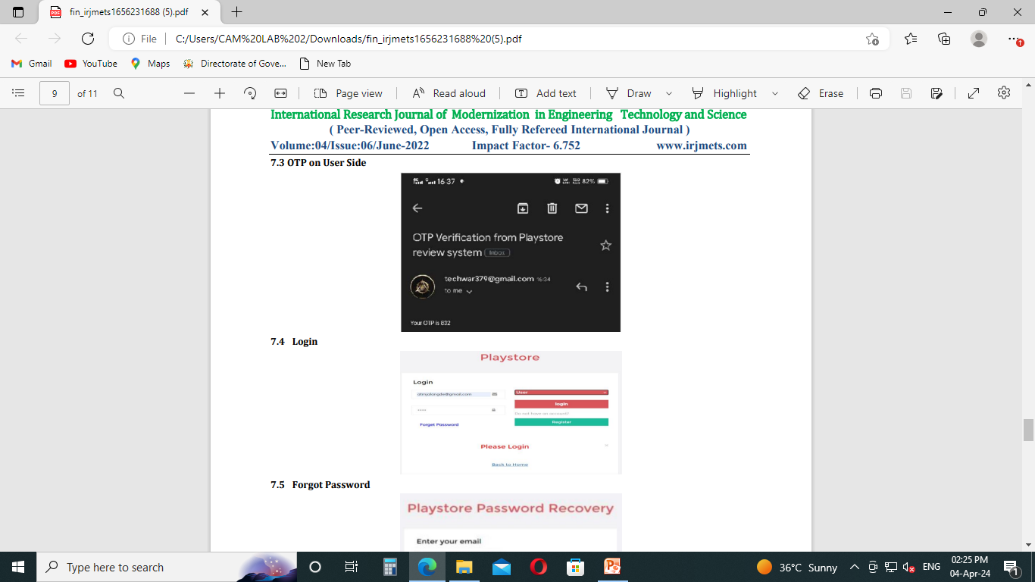
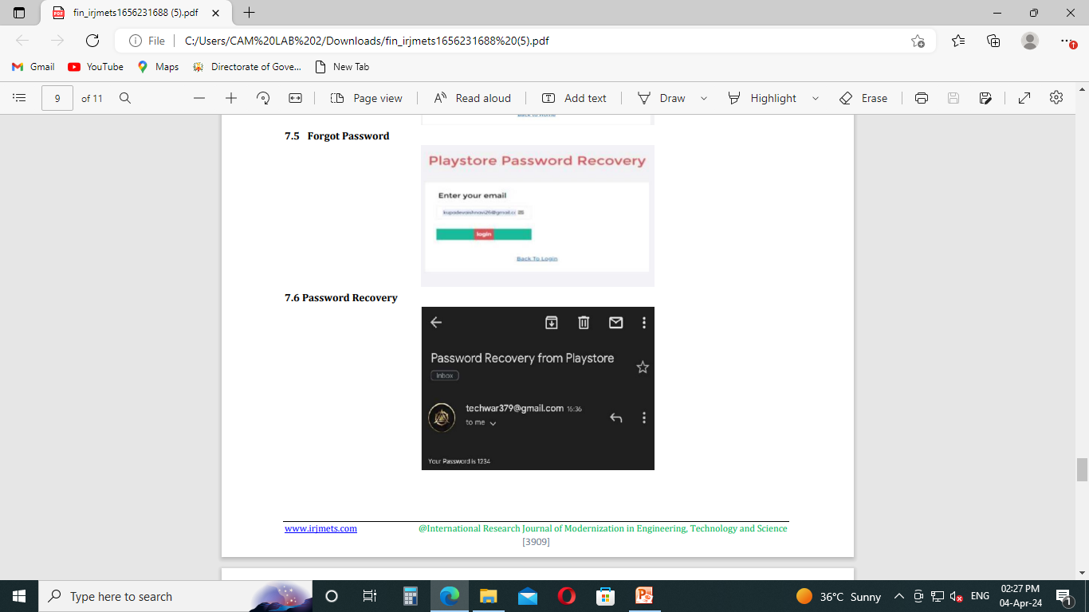

Slide 16
SCOPE AND FUTURE WORK
Going to continue to dig deeper, far past the surface of the number of likes, comments and shares, and aim to reach, and truly understand, the significance of social media interactions and what they tell us about the consumers behind the screens.
Updating dictionary for synonyms and antonyms: Update the dictionary to easily recognize the what user can say actually means, the shortcuts of any word or any word related to that word and all can update into that dictionary.

Slide 17
Web application can be converted into mobile application: Now, it is on website application, but in future it can converted into mobile application for flexibility to mobile users.
Can be created in other languages using Data sets and algorithm: Now, it is on US English, but for the user understanding or user-friendly purpose it will make it on other languages also by using Data sets and Google Translator.
In future it may be an automate feature by the Google play stor

Slide 18
CONCLUSION
Today’s world Google play store has become the major hub for downloading and uploading Android application.
The Android application users download applications for their personal use.
Each user of the application has their own experience with the application.
As an outcome of the project, the comments can be sent to owner

Slide 19
REFERENCES
Rishi Meridian, “Analysis of Google Play Store Data set and predict the popularity of an app on Google Play Store”, Texas a&M University College Station, Texas, June-2020. Jong, J.
(2011). Predicting rating with sentiment analysis.[Online] http://cs229.stanford.eddo/proj2011/JongPredictingRatingwithSentimentAnalysis.pdf.

Slide 20
https://en.wikipedia.org/wiki/Sentiment_analysis [3] Harman, M., Jiao, Y., and Zhang, Y. (2012).
App store mining and analysis: Mrs for app Stores. In 2012 9th IEEE Working Conference on Mining Software Repositories (MSR), Pages 108–111.
https://developer.mozilla.org/en-US/docs/Learn/Serverside/Django/Introduction
https://jovian.ai/learn/data-analysis-with-python-zero-topandas

Slide 21
THANK YOU

